Slide 1
Semantic Segmentation

Slide 2
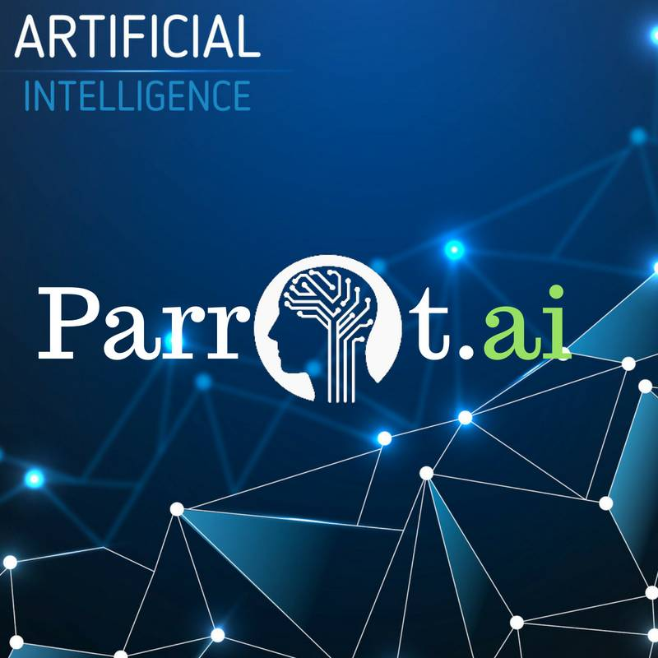
Hello!
I am Frederick Apina
Machine Learning Engineer @ParrotAI I am here because I love to give presentations.

Slide 3
“When I think about strong innovations in term of automation, cognitive computing, and artificial intelligence, they will be coming a lot from Tanzania as well.”

Slide 4
1.
What is semantic segmentation?

Slide 5
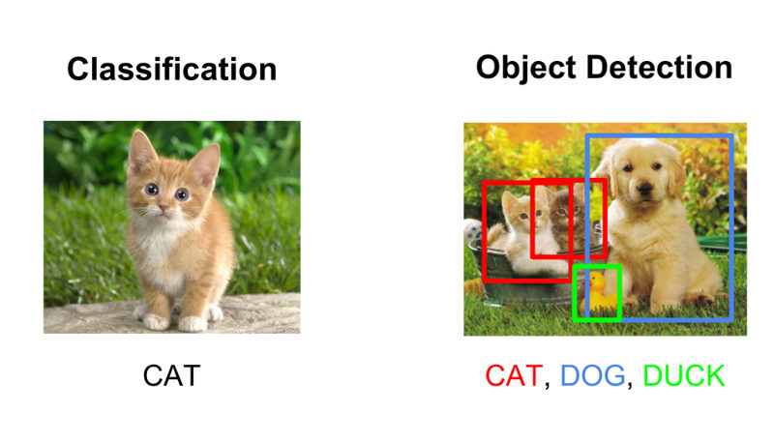

Slide 6
Limitations
Still a bit rough since we’re only drawing bounding boxes and don’t really get an accurate idea of object shape.

Slide 7
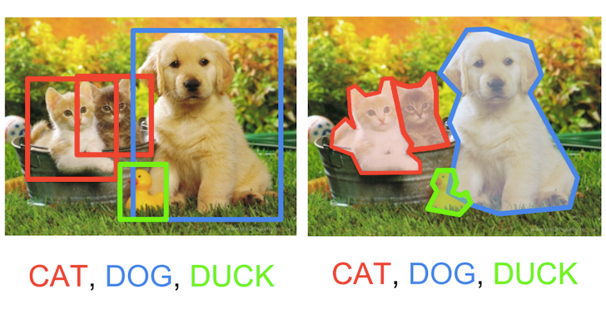
What if!?

Slide 8
Semantic Segmentation
Semantic Segmentation is to label each pixel of an image with a corresponding class of what is being represented.
commonly referred to as dense prediction.

Slide 9
2.
Applications of Semantic Segmentation

Slide 10
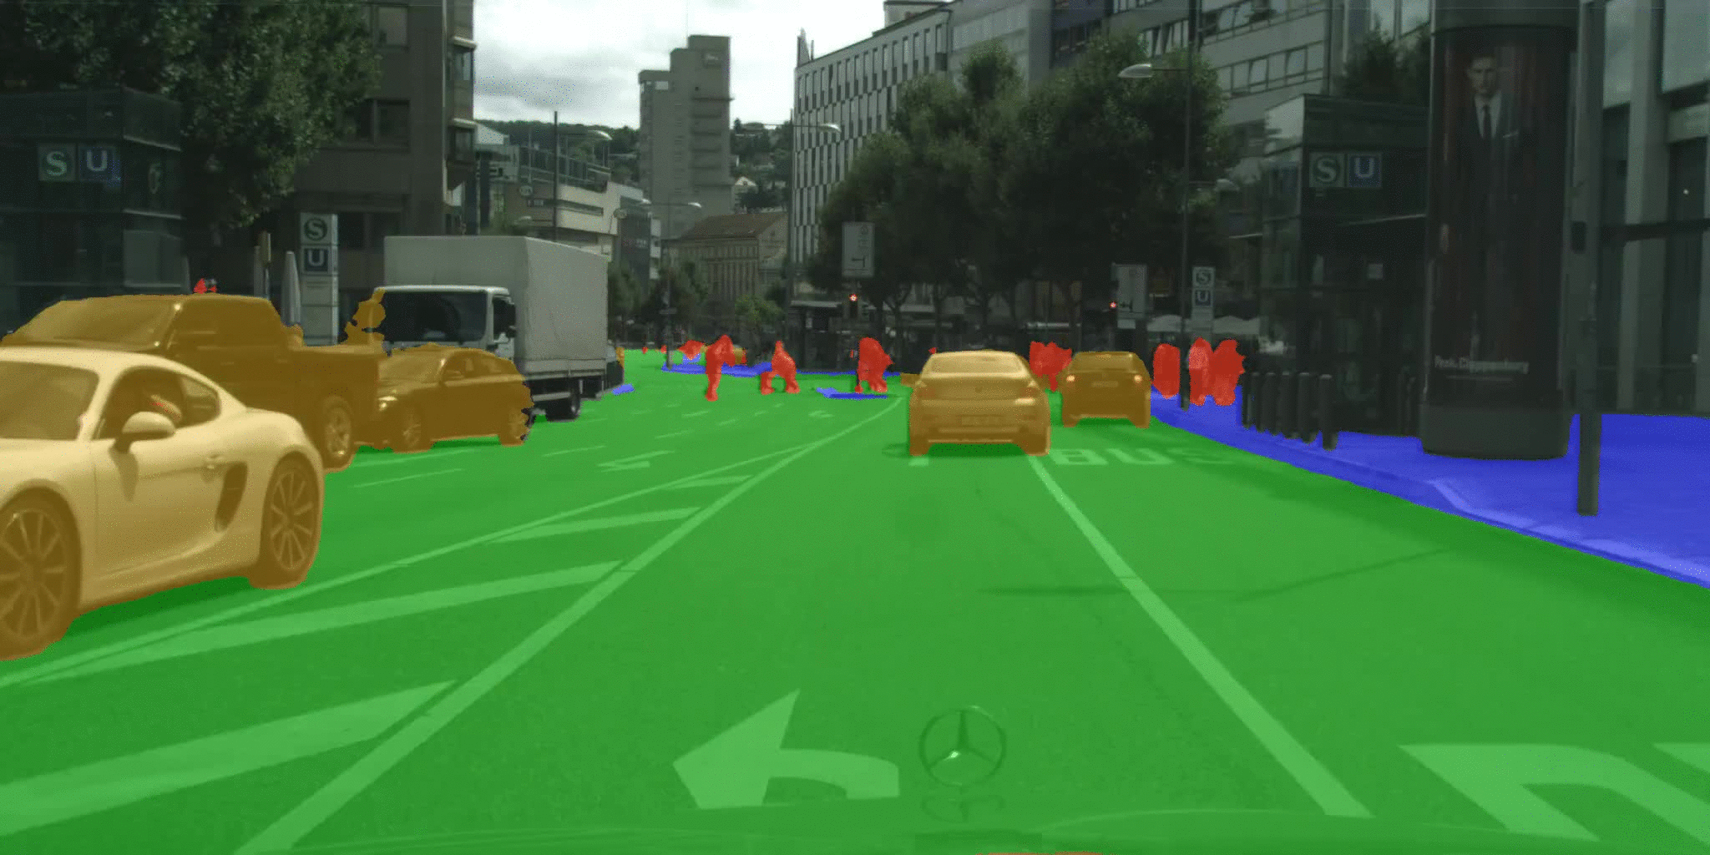
Autonomous Vehicles

Slide 11
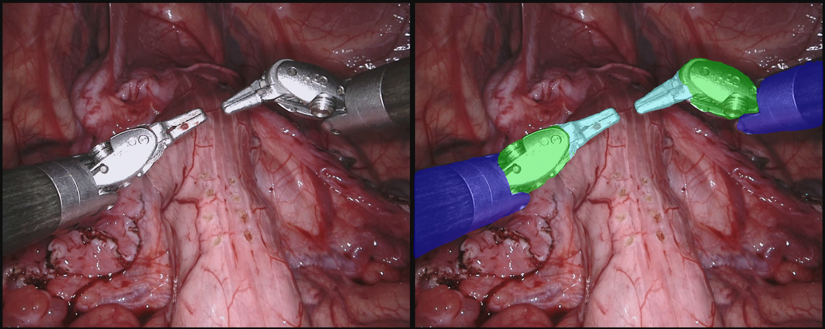
Medical Surgeries

Slide 12
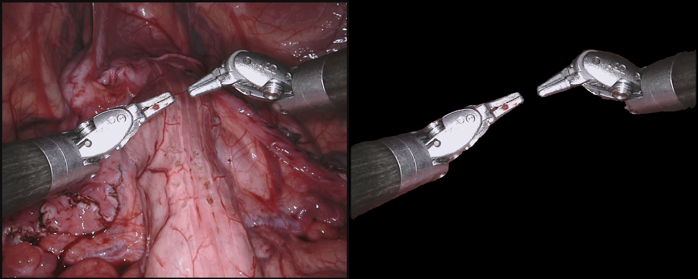
Medical Surgeries

Slide 13
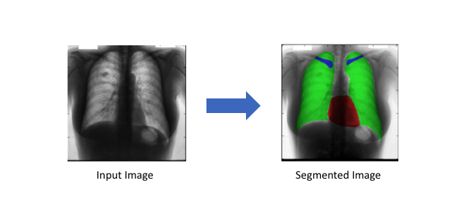
Medical Images Diagnostics

Slide 14
3.
Representing the Task

Slide 15
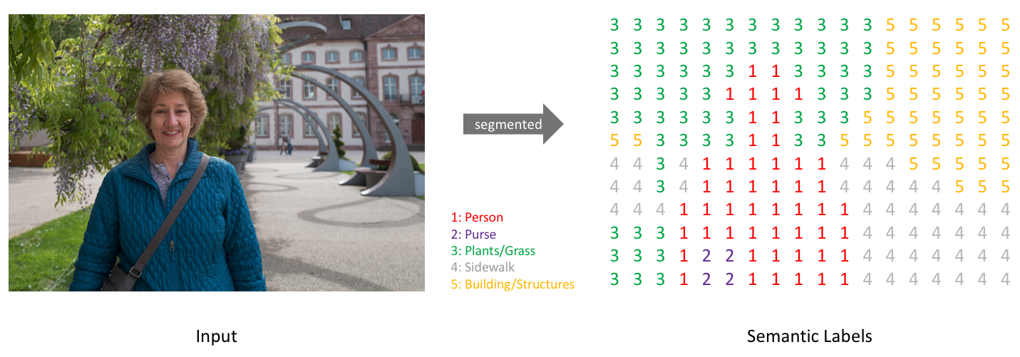
Our goal is to take either a RGB color image or a grayscale image and output a segmentation map where each pixel contains a class label represented as an integer.

Slide 16
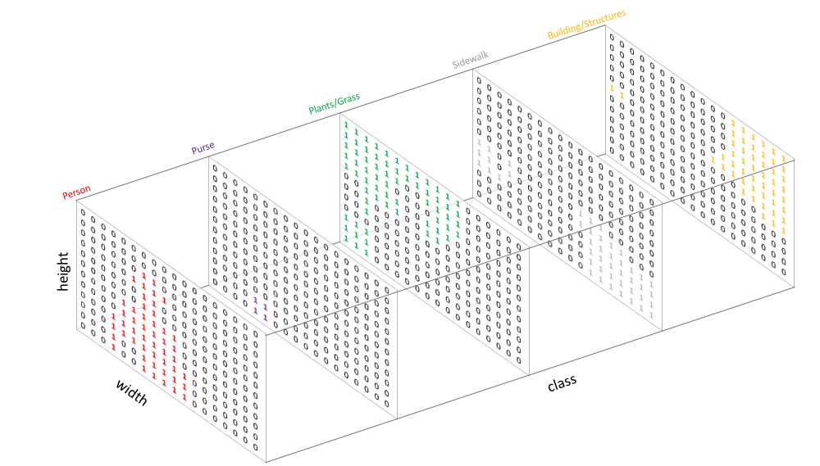
We create our target by one-hot encoding the class labels - essentially creating an output channel for each of the possible classes.

Slide 17
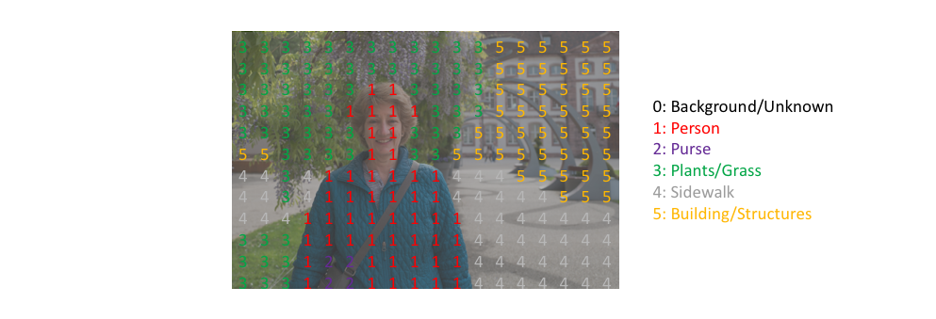
We can easily inspect a target by overlaying it onto the observation.
When we overlay a single channel of our target (or prediction), we refer to this as a mask which illuminates the regions of an image where a specific class is present.

Slide 18
3.
Constructing an Architecture

Slide 19
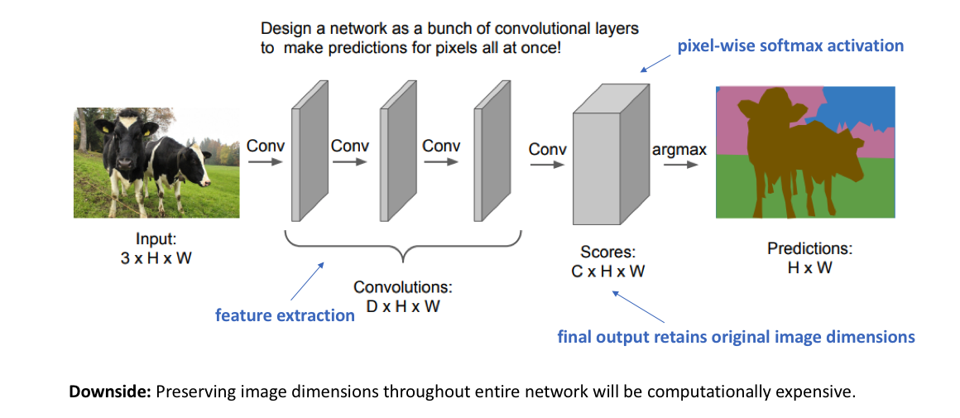
A naive approach…

Slide 20
Recall that for deep convolutional networks, earlier layers tend to learn low-level concepts while later layers develop more high-level (and specialized) feature mappings. In order to maintain expressiveness, we typically need to increase the number of feature maps (channels) as we get deeper in the network.

Slide 21
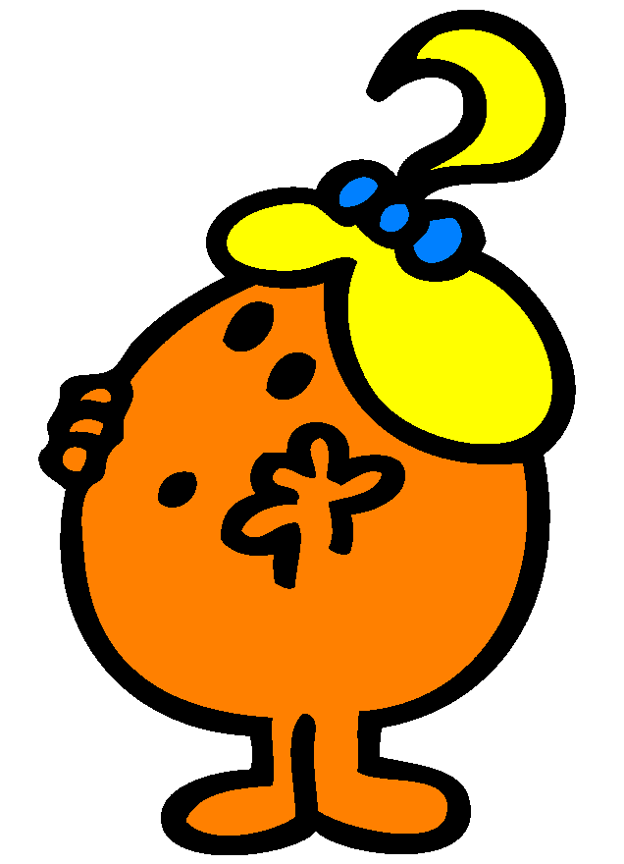
Solution?

Slide 22
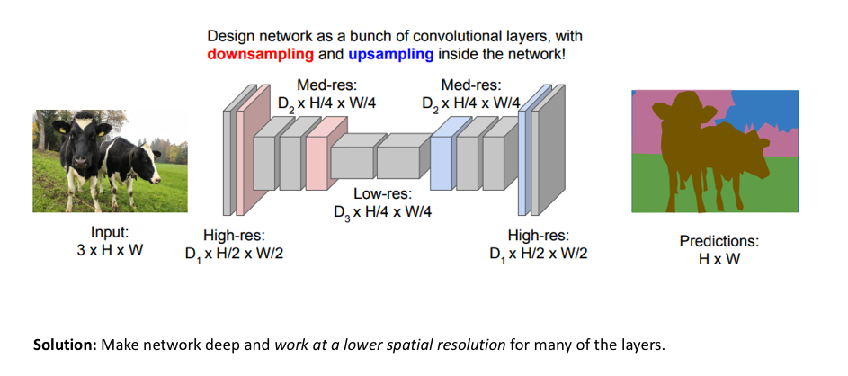
Lucky for us..
One popular approach for image segmentation models is to follow an encoder/decoder structure.

Slide 23

U-Net Architecture..
Consists of a contracting path to capture context and a symmetric expanding path that enables precise localization.

Slide 24
Advanced U-Net variants
The standard U-Net model consists of a series of convolution operations for each "block" in the architecture.
Proposed: swap out the basic stacked convolution blocks in favor of residual blocks. This residual block introduces short skip connections (within the block) alongside the existing long skip connections (between the corresponding feature maps of encoder and decoder modules) found in the standard U-Net structure.

Slide 25
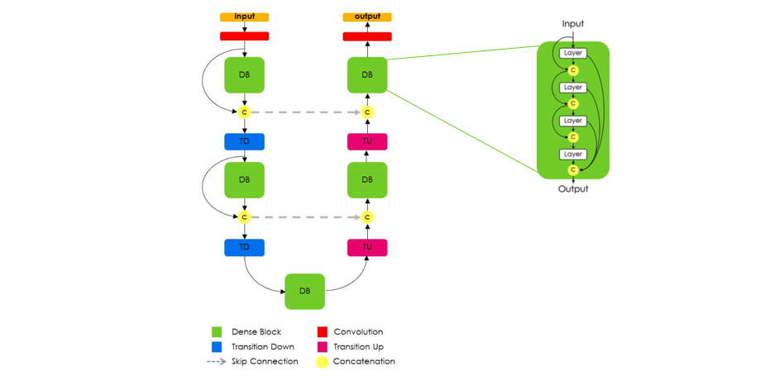
Tiramisu: Full Convolution DenseNet
Tiramisu adopts the UNet design with downsampling, bottleneck, and upsampling paths and skip connections. It replaces convolution and max pooling layers with Dense blocks from the DenseNet architecture. Dense blocks contain residual connections.

Slide 26
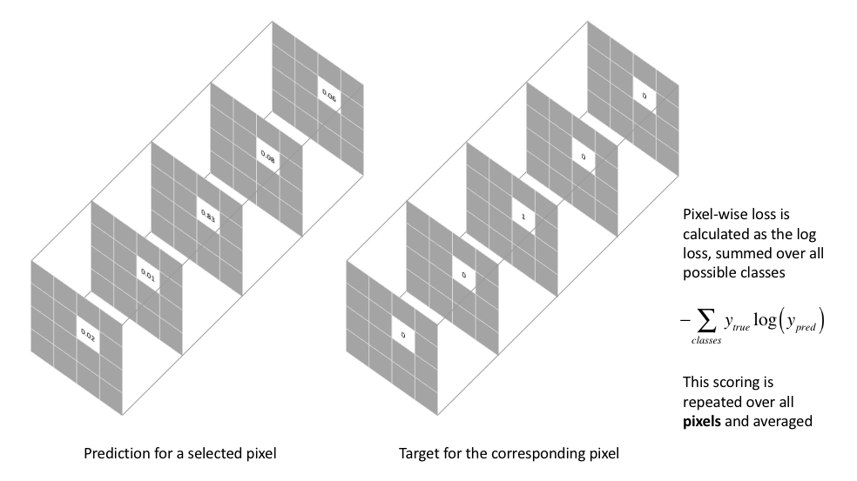
Defining loss function
The most commonly used loss function for the task of image segmentation is a pixel-wise cross entropy loss. This loss examines each pixel individually, comparing the class predictions (depth-wise pixel vector) to our one-hot encoded target vector.

Slide 27
Conclusion
Deep Learning is an continuously-growing and a relatively new concept, the vast amount of resources can be a touch overwhelming for those either looking to get into the field, or those already engraved in it. A good way of cooping is to get a good general knowledge of machine learning and then find a good structured path to follow (be a project or research).

Slide 28
Thanks!
Any questions?
You can find me at:
Fred@parrotai.co.tz

